Slide 1
Throwback
NMT with Attention
IAC Deep Learning Course

Slide 2
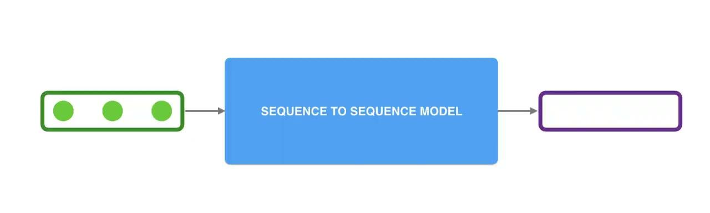
Seq2Seq [Paper 1] [Paper 2]
A sequence-to-sequence model is a model that takes a sequence of items (words, letters, features of an images…etc) and outputs another sequence of items. A trained model would work like this:

Slide 3
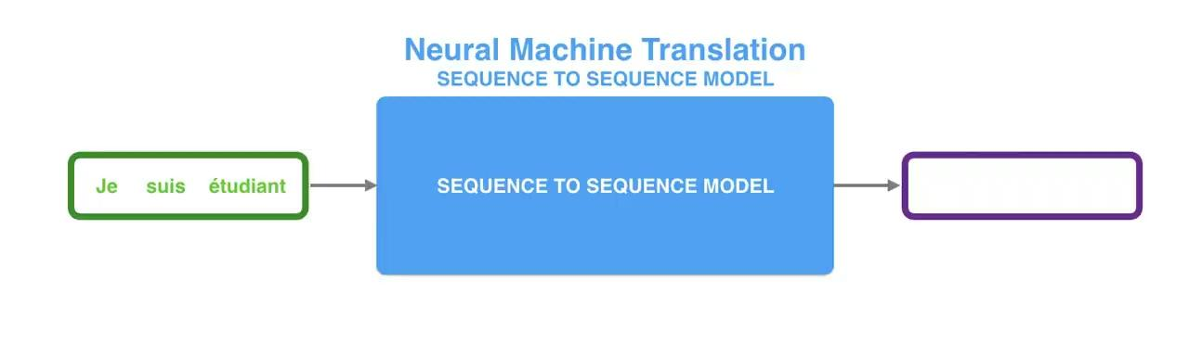
NMT
In neural machine translation, a sequence is a series of words, processed one after another.

Slide 4
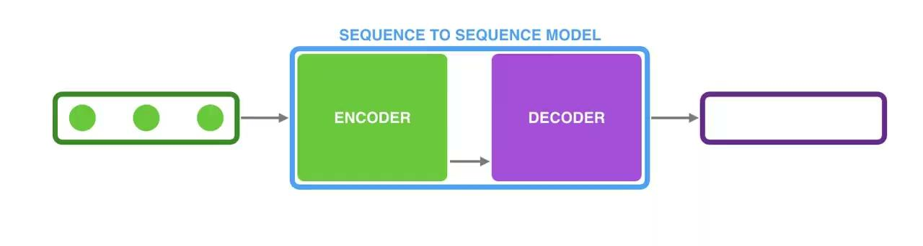
The Encoder Decoder Model

Slide 5
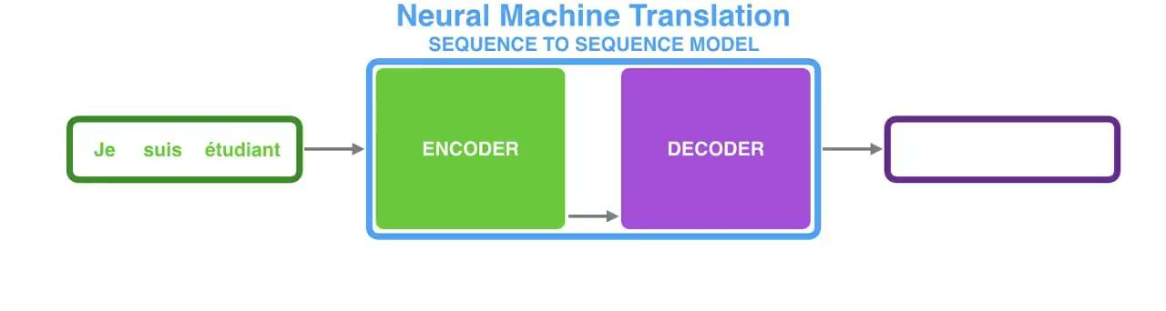
The Encoder Decoder Model for NMT
Remember RNN?

Slide 6
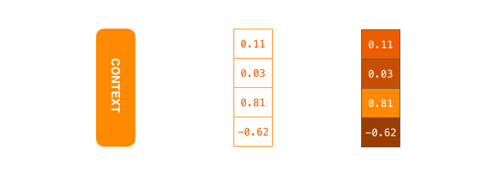
The Context Vector
The context is a vector of floats. It is basically the number of hidden units in the encoder RNN.

Slide 7
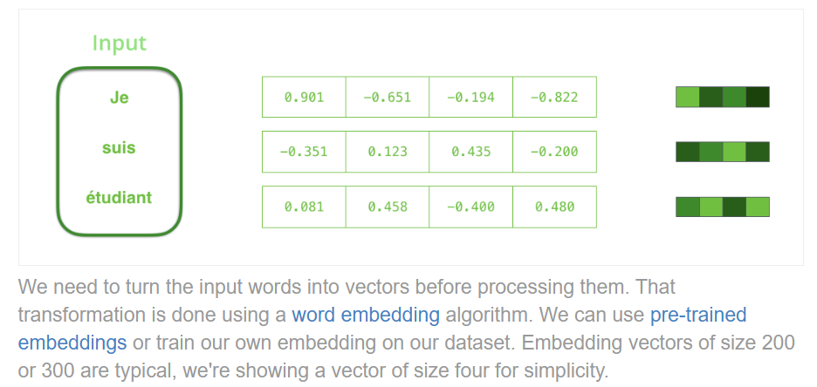
Word Embedding

Slide 8
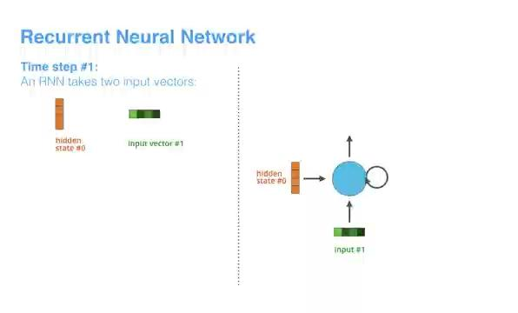
RNN Recap

Slide 9
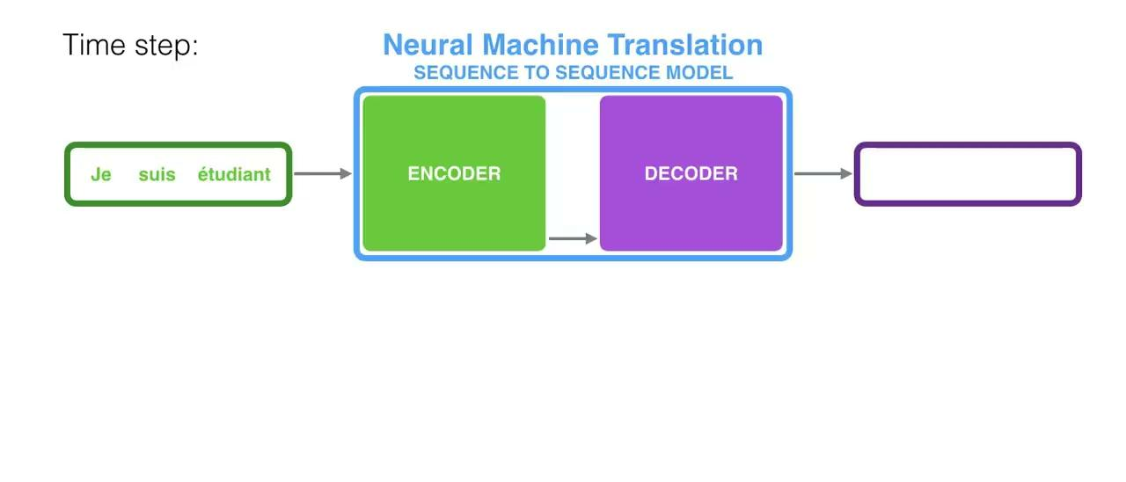
NMT with Encoder Visualized

Slide 10
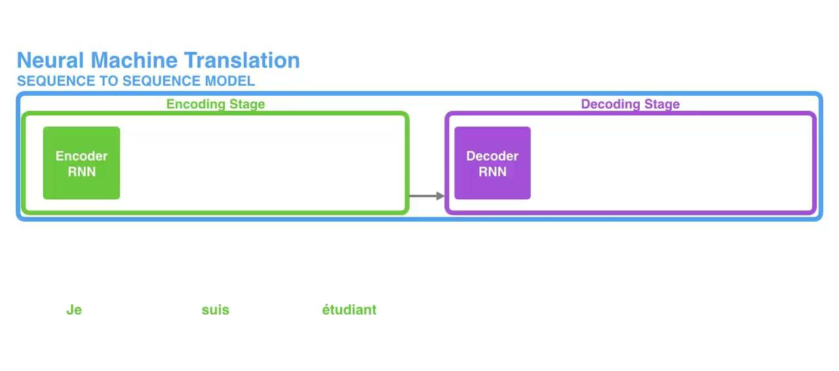
NMT with Encoder and Decoder Unrolled

Slide 11
Can you guess the problem?
What would happen if the sentence is too long?
Which part of the sentence impacts the context vector most?
Does this create any bias for the Decode?
Can you think of a solution to this?

Slide 12
May I have your Attention?
The context vector turned out to be a bottleneck for these types of models. It made it challenging for the models to deal with long sentences.
A solution was proposed in Bahdanau et al., 2014 and Luong et al., 2015.
These papers introduced and refined a technique called “Attention”, which highly improved the quality of machine translation systems.
Attention allows the model to focus on the relevant parts of the input sequence as needed.
An attention model differs from a classic sequence-to-sequence model in two main ways

Slide 13
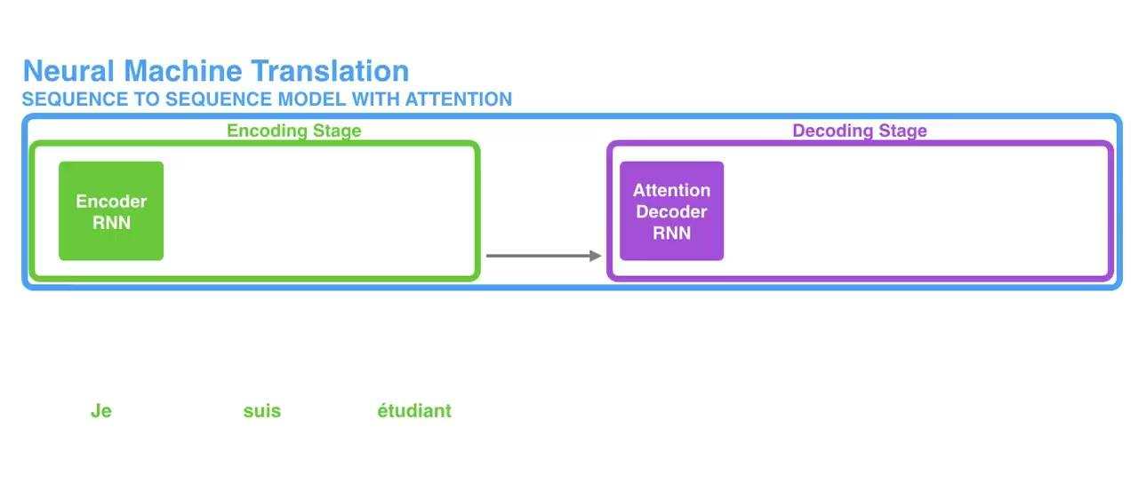
Attention: Difference 1 [Passing all Hidden States]

Slide 14
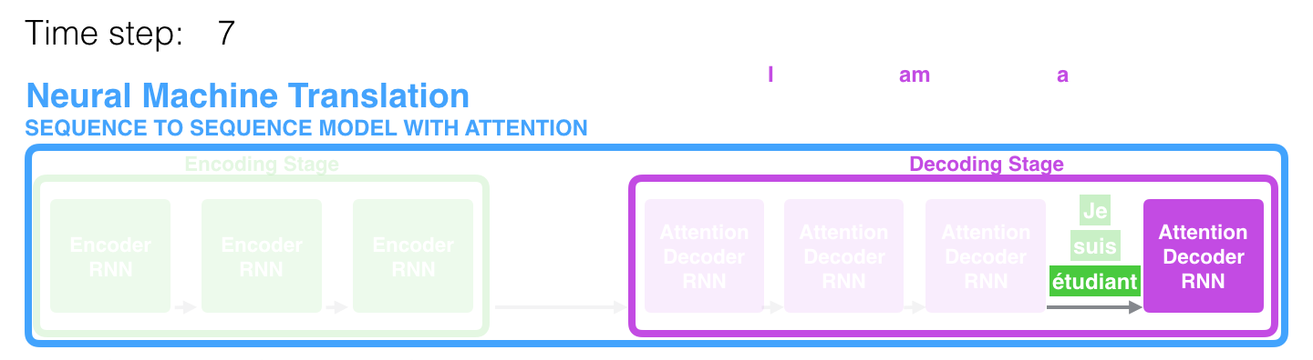
Attention aided Decoding
At time step 7, the attention mechanism enables the decoder to focus on the word "étudiant" ("student" in french) before it generates the English translation.

Slide 15
Attention: Difference 2
An attention decoder does an extra step before producing its output. In order to focus on the parts of the input that are relevant to this decoding time step, the decoder does the following:
Look at the set of encoder hidden states it received – each encoder hidden state is most associated with a certain word in the input sentence
Give each hidden state a score (let’s ignore how the scoring is done for now)
Multiply each hidden state by its softmaxed score, thus amplifying hidden states with high scores, and drowning out hidden states with low scores

Slide 16
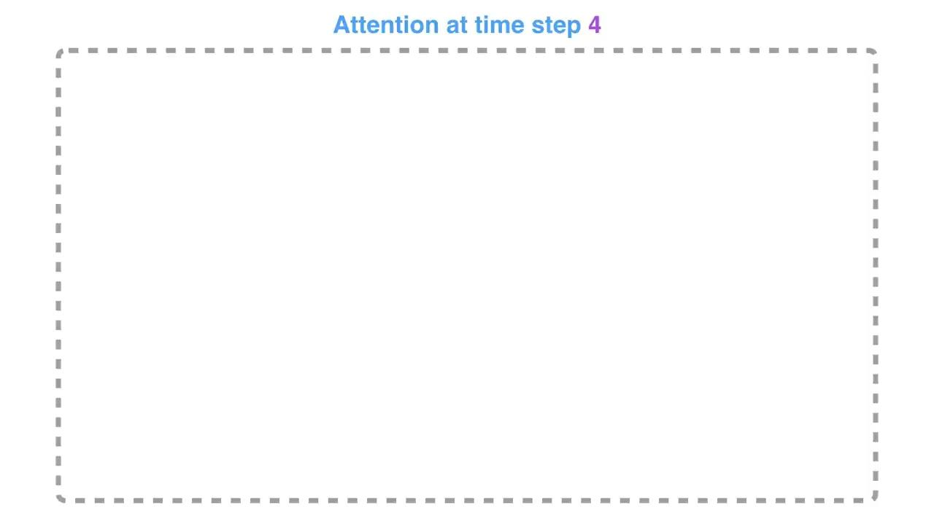
Attention: Difference 2

Slide 17
Stitching everything together
The attention decoder RNN takes in the embedding of the <END> token, and an initial decoder hidden state.The RNN processes its inputs, producing an output and a new hidden state vector (h4). The output is discarded.
Attention Step: We use the encoder hidden states and the h4 vector to calculate a context vector (C4) for this time step.
We concatenate h4 and C4 into one vector.
We pass this vector through a feedforward neural network (one trained jointly with the model).
The output of the feedforward neural networks indicates the output word of this time step.
Repeat for the next time steps

Slide 18
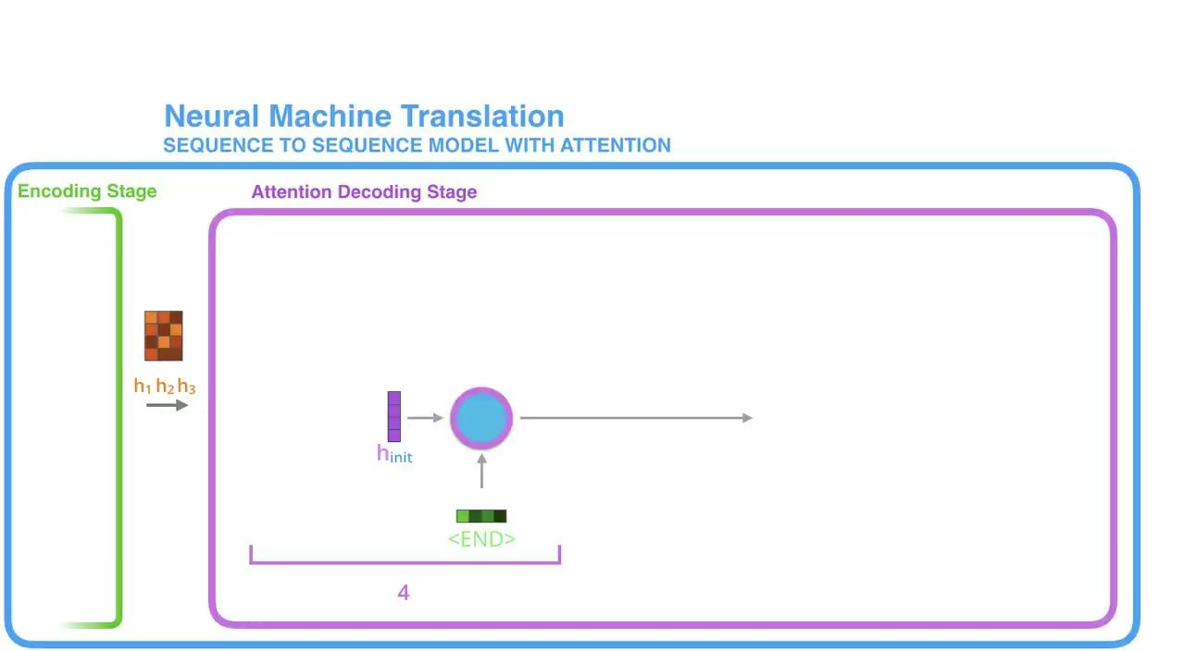
Stitching everything together

Slide 19
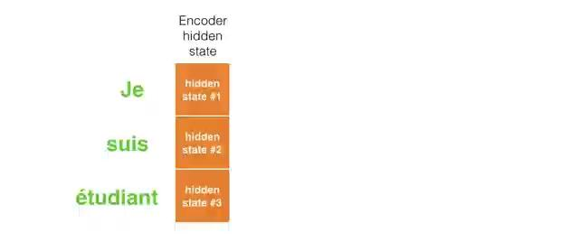
Some Intuition

Slide 20
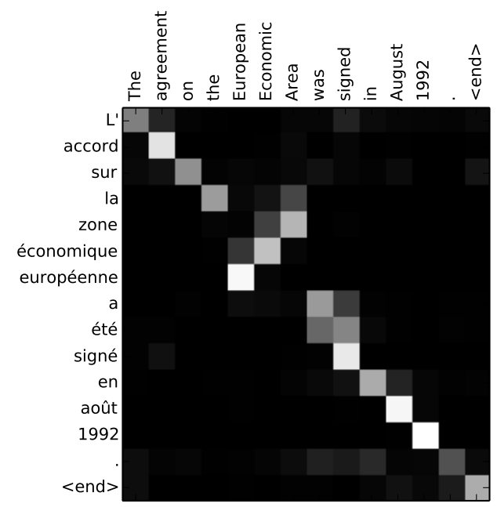
Some Intuition
You can see how the model paid attention correctly when outputing "European Economic Area". In French, the order of these words is reversed ("européenne économique zone") as compared to English. Every other word in the sentence is in similar order.

Slide 21
So, what is the catch!
Not fast enough!
Does not scale well for very large sequences

